Slide 1
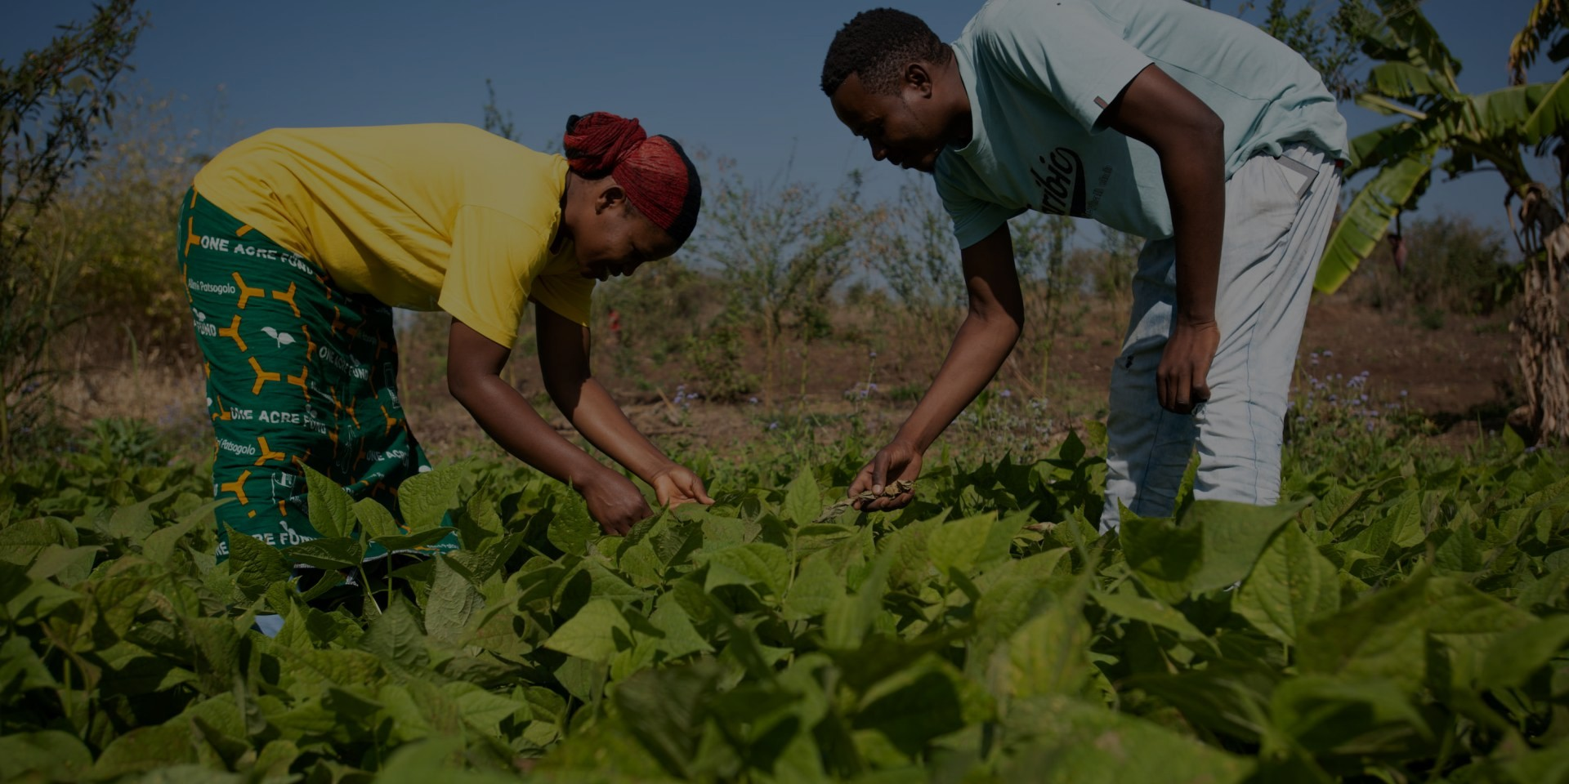

The Economic Case for Mandatory Human Rights and Environmental Due Diligence (mHREDD) in Malawi
Bertha Bangara Chikadza, PhD
Economics Association of Malawi
Lifestyle Boutique)
Thursday, 5th February, 2026

Slide 2
Outline
Introduction
Context and Rationale
Why this discussion Matters for Malawi
Question 1: Hidden Costs?
Question 2: Investor Confidence
Question 3: Short term vs long term
Question 4: Public Finance Impact
Question 5: Inclusive Growth
Conclusion

Slide 3
Introduction

Slide 4
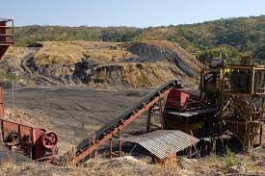
1. Malawi
There’s increasing investment in mining, agriculture, and infrastructure without a mandatory framework to manage human rights and environmental risks.
Global shift toward mandatory due diligence (UNGPs, OECD)
Africa moving ahead (Kenya, South Africa, Nigeria)
Malawi lacks binding mHREDD despite constitutional guarantees
But weak protections do not mean “low cost”—they shift costs from firms to communities, government, and future generations

Slide 5
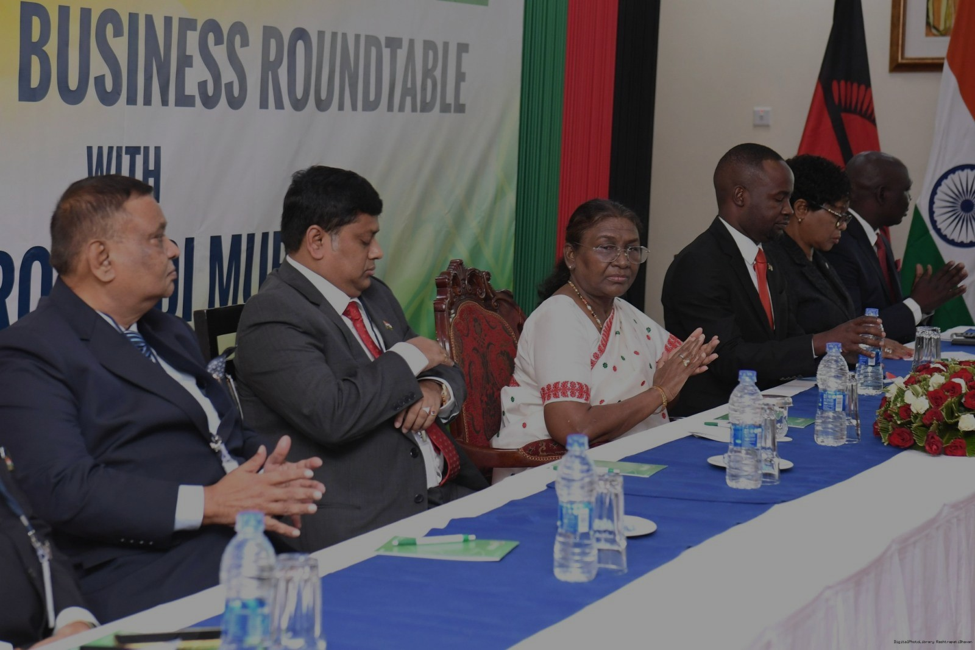
2. Why this discussion matters for Malawi?
The investment case
What donors care about
• Safeguards: fewer project disruptions, lower contingency costs
• System reforms: stronger institutions + data for oversight
• Value for money: prevent harms that later require public spending, Coherence: aligns with UNGPs and OECD due diligence guidance
A predictable “rules of the game”
lowers risk premiums and attracts
long-term capital.
Economic activity remains; mHREDD is not just a compliance issue, not a regulatory burden but an economic governance issue, risk-management and value-creation too.
Rising land conflicts, environmental degradation, labour disputes
Weak benefit-sharing in resource sectors
Growing pressure from global markets and investors
There is an emphasizes that without due diligence obligations, Malawi risks higher governance challenges as investment grows
What the private sector gets
• Access to buyers and finance that require ESG / due diligence evidence
• Faster permitting and fewer community conflicts (license to operate)
• Level playing field: reduces “race to the bottom” competition
• Stronger brands and resilient supply chains

Slide 6
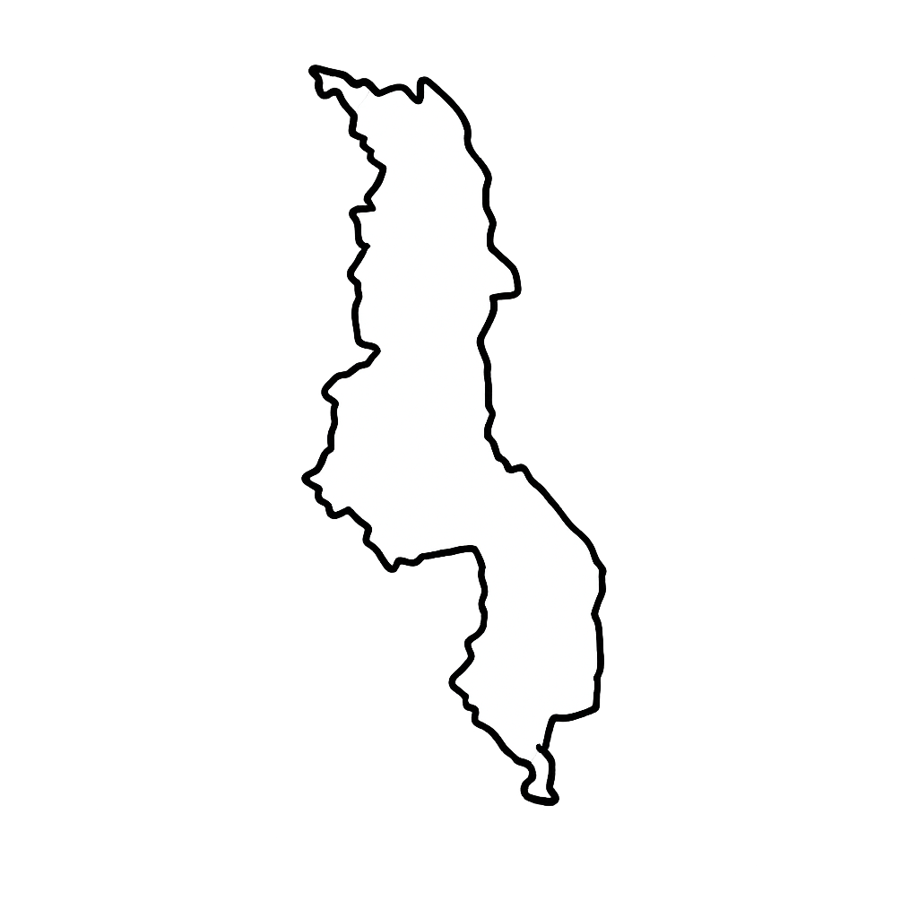
3. Malawi’s risk content (why inaction is costly)
Natural resources (mining, agriculture, forestry) underpin over 80% of rural livelihoods
Agriculture accounts for ~25–30% of GDP and over 80% of exports
Mining projects have experienced land disputes, compensation delays, and community resistance
Economic implication
Weak safeguards = project delays, reputational damage, and fiscal leakage
Macro +real economy
Environmental degradation and unresolved grievances are not “externalities”
— they show up as lost productivity, infrastructure damage, and fiscal pressure.
Estimated annual cost of land degradation (2001–2009, 2007 prices)
How mHREDD changes the cost curve
US$ 244m
≈ 6.8% of GDP (World Bank CEA)
Identifies risks early (before permits, capex, and land acquisition)
Sets prevention/mitigation duties
Requires grievance channels + remedy
Reduces disruption, clean-up, and compensation shocks
Land under serious pressure
> 60%
Soil erosion & nutrient depletion affect >60% of land area
Average annual soil loss (2014 estimate)
29 t/ha
Higher erosion raises flood/siltation risks

Slide 7
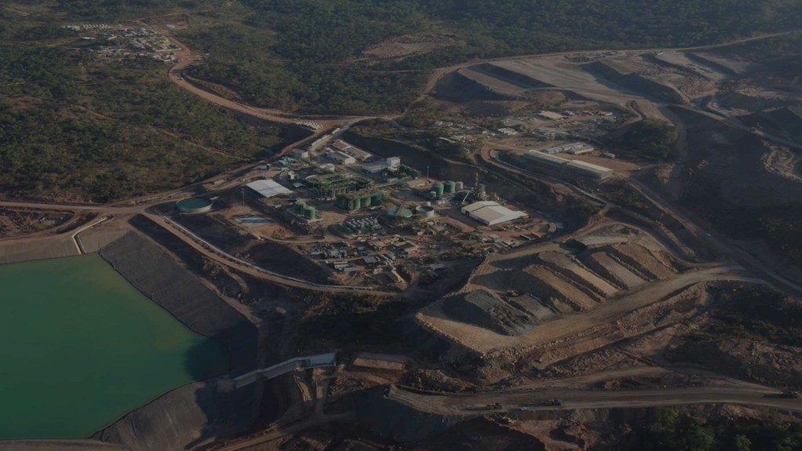
4. Hidden Costs.
What are weak protections costing Malawi?
↓ GDP growth from disrupted livelihoods
↑ fiscal pressure from remediation and compensation
↑ investment risk premiums
↓ export competitiveness due to reputational risks
These are not abstract risks—they translate directly into weaker growth and higher debt pressures.
What mHREDD would operationalize
• Ongoing risk identification with affected stakeholders
• Prevent/mitigate and track effectiveness
• Transparent disclosure
• Grievance + remedy (and escalation pathways)
What independent reporting found
Human Rights Watch documented serious problems for families living near coal and uranium mining operations in Karonga (water, food, housing) and gaps in protection and transparency.
For investors and lenders, these translate into: delays, higher security/engagement costs, reputational exposure, and potential liabilities.

Slide 8
Can robust due diligence attract investors?

Slide 9
5. Can robust due diligence attract investors and open doors to global markets? (Investor Confidence)
The global rulebook
Investors and lead firms increasingly require evidence of due diligence
across value chains. Malawi firms that can document systems win contracts and finance.
2011
2018
2024
UN Guiding Principles
(Protect–Respect–Remedy)
OECD Due Diligence
Guidance (RBC)
EU CSDDD
Directive 2024/1760
Implication for Malawi
• Exporters and suppliers will face “pass-through” requirements from EU/UK/US buyers and financiers.
• A national framework reduces uncertainty and supports credible assurance.
• Donor support can lower compliance costs through shared tools (templates, training, digital reporting).

Slide 10
6. Investor Confidence (market access)
Trade + supply chains
Malawi’s export base is concentrated. Meeting due diligence expectations helps protect
key earnings today and enables diversification into higher-value markets tomorrow.
Tobacco leaf as % of total exports (2020)
Why this matters for investors and buyers
Concentration increases vulnerability to compliance shocks.
Due diligence supports traceability, labor standards, and environmental management across supply chains.
Aligning Malawi’s framework with global expectations reduces transaction costs for investors (shared baselines).
Agriculture remains Malawi’s major export earner (reported at ~59% in 2023).

Slide 11

7. Can robust due diligence attract investors and open doors to global markets? (Investor Confidence)
Yes, mHREDD is increasingly a market access requirement, not a barrier. Global buyers demand traceability and ESG compliance
Responsible investors avoid high-risk jurisdictions
Alignment with OECD and UNGPs increases credibility
Human rights due diligence, Environmental traceability
Conflict-free supply chains
Without mHREDD, Malawian firms risk exclusion from:
Ethical mineral supply chains, Sustainable agriculture markets
ESG-aligned financing
mHREDD as a tool to align Malawi with global standards, enhancing its attractiveness to long-term investors

Slide 12
Are we paying more by ignoring mHREDD?

Slide 13
8. Short term vs long term: Are we paying more?
Cost of inaction vs cost of implementation
Adecision framing
mHREDD is often perceived as a compliance cost. In practice it is a risk-management
capability that reduces the probability and severity of high-cost shocks.
Ignore / minimal due diligence
Partial / ad-hoc compliance
Higher probability of conflicts
More stoppages & redesign
Higher financing spreads
Reputational exposure
Audit fatigue
Inconsistent supplier checks
Weak remedy channels
Shock costs ↓
Preventive due diligence
Strategic mHREDD + shared tools
Lowest expected cost
Faster contracting
Improved productivity
Strong license to operate
Stable operations
Fewer surprises
Better data & governance
Easier access to ESG capital
Implementation effort →

Slide 14
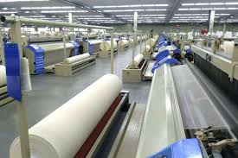
9. Investor Confidence – Malawi Gains
Lower perceived country risk
Lower cost of capital
Improved ESG ratings
Access to ethical supply chains (EU, US)
More patient, long-term capital
Reduced project disputes and delays
This shifts Malawi away from “race to the bottom” investment toward quality investment.

Slide 15
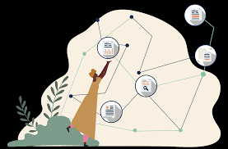
10. Ignoring mHREDD…
Delaying mHREDD is more expensive than adopting it gradually now.
Short-term “savings” = long-term liabilities
Crisis-driven regulation costs more than planned reform
Policy instability and uncertainty discourages investors
Conflict compensation, investment without safeguards
Environmental degradation, Community grievance emerges
Arbitration and litigation, Social instability
Project stalls → donor mediation
Public funds absorb resolution costs
Prevention is cheaper than crisis response

Slide 16

11. Implementing mHREDD…
Implementing mHREDD changes the sequence
Compliance systems lead to early risk identification
Capacity building and community engagement
Regulatory oversight and lower probability of conflict
HREDD is a preventive governance—cheaper than remediation after harm occurs, planned and manageable.

Slide 17
Public Finance Impact of mHREDD

Slide 18
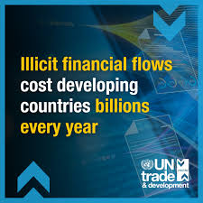
12. How mHREDD can help govt reduce flows and strengthen revenue
mHREDD strengthens transparency, accountability, and tax integrity
Improved disclosure of ownership and operations
Reduced transfer mispricing and under-reporting
Stronger monitoring of extractives and agribusiness
By clarifying corporate responsibilities and supply chains, mHREDD complements revenue administration and anti-corruption efforts

Slide 19
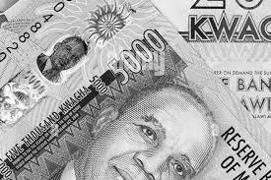
13. Fiscal (Public Finance) Benefits for Malawi
Malawi context
High aid dependence & persistent fiscal stress
Concerns over illicit financial flows in extractives
mHREDD
Improves transparency across value chains hence more predictable revenue flows
Supports tax compliance hence lower enforcement costs
Strengthens monitoring of concessions and licenses, Better value from natural resources
Stronger social contract
mHREDD is a fiscal governance reform, not just a human rights tool. It complements—not replaces—tax and anti-corruption reforms by addressing risk at the source

Slide 20
Can smart due diligence frameworks support SMEs and prevent conflicts in Communities?

Slide 21

14. YES…
Well-designed mHREDD can level the playing field and protect SMEs.
Proportional requirements for SMEs, simplified reporting, technical assistance
Clear standards reduce arbitrary enforcement
Stronger community engagement reduces conflict
Meaningful community participation and inclusive stakeholder engagement are central to mHREDD

Slide 22
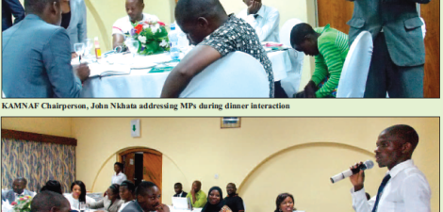
15. Inclusive growth
SME-friendly design
Smart mHREDD frameworks can be proportional: the same baseline expectations, with simplified tools and staged requirements for SMEs.
Estimated MSME contribution (Malawi)
~40%
Share of GDP (est.)
What “proportionality” can look like
Employment supported by MSMEs (est.)
Standard templates for risk screening
Sector toolkits (agri, mining, construction)
Shared grievance channels and mediation support
Training and advisory services via chambers/associations
~24%
Share of employment (est.)

Slide 23

16. Community Stability = Business Stability and SME Growth
Land and resource conflicts raise costs for all firms
SMEs lack buffers to absorb disruptions
mHREDD brings
Clear engagement rules, reduced arbitrary enforcement
Lower conflict risk, fewer land disputes
Better benefit-sharing
Improved trust between firms and communities
Reduced operational disruptions
Preventing conflict is cheaper than managing it—and SMEs benefit the most from predictability.

Slide 24
Conclusion

Slide 25
17. Conclusion
Weak protections impose real economic costs
Prevention is cheaper than remediation
SME enablement thru advisory services; shared reporting tools; phased compliance for smaller firms increases growth.
mHREDD improves investor confidence and market access
Inclusive frameworks support SMEs and social stability
Mandatory human rights and environmental due diligence is not anti-business—it is pro-development, pro-stability, and pro-growth.”
Public finance benefits are substantial

Slide 26
THANK YOU!

